Slide 1
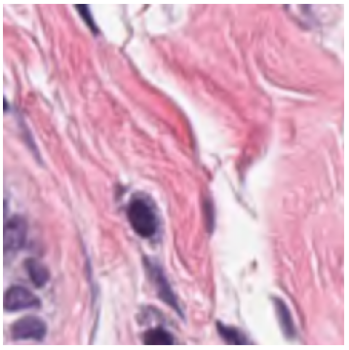
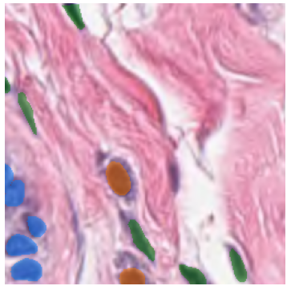
RESBLOCK
64x256x256
64x256x256
+
|
DOWNBLOCK
128x128x128
128x128x128
64x256x256
3x256x256
64x256x256
UPBLOCK
6x256x256
128x128x128
+
DOWNBLOCK
|
128x128x128
+
256x64x64
DOWNBLOCK
256x64x64
|
UPBLOCK
256x64x64
256x64x64
512x32x32
+
512x32x32
1024x32x32
512x32x32
|
512x32x32
UPBLOCK
ENCODER
BOTTLENECK
UPBLOCK, UPSAMPLE=FALSE
DECODER

Slide 2
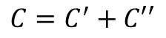
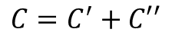
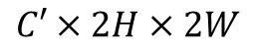
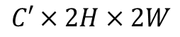
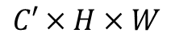
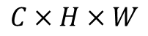
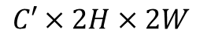
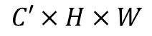
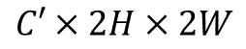
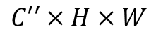
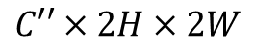
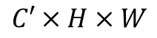
UPSAMPLE=TRUE
UPSAMPLE=FALSE
$$C×H×W$$
Input (x)
$$C′×H×W$$
Input (x)
ConvTranspose2d
(2x2, stride=2)
$$C′×2H×2W$$
$$C′′×2H×2W$$
$$C′′×H×W$$
CONSTRAIN:
|
Skip
Connection
CONSTRAIN:
|
Skip
Connection
$$C=C^{′}+C′′$$
$$C=C^{′}+C′′$$
$$C′×2H×2W$$
double_conv[0]
(Conv2D 3x3 + BN + ReLU)
$$C′×H×W$$
double_conv[0]
(Conv2D 3x3 + BN + ReLU)
double_conv[1]
(Conv2D 3x3 + BN + ReLU)
double_conv[1]
(Conv2D 3x3 + BN + ReLU)
$$C′×2H×2W$$
$$C′×H×W$$
$$C′×2H×2W$$
Output
$$C′×H×W$$
Output

Slide 3
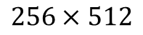
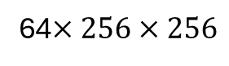
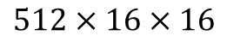
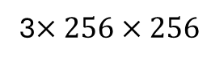
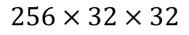
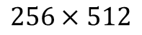
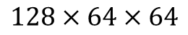
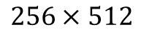
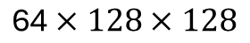
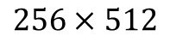
3$×256×256$
Input (x)
conv0 (ConvBlock)
(3x3 + BN + ReLU)
64$×256×256$
$$256×512$$
In tokens
conv1 (ConvBlock)
(3x3 s=2+ BN + ReLU)
Layer Norm
$$\text{64}×128×128$$
conv1
conv2 (ConvBlock)
(3x3 s=2+ BN + ReLU)
MHSA (h=4)
$$\text{128}×64×64$$
conv2
conv3 (ConvBlock)
(3x3 s=2+ BN + ReLU)
Add & Layer Norm
Transformer Encoder (x7)
$$\text{256}×32×32$$
conv3
projection
(3x3 s=2)
Feed Forward
FC(1024) + GeLU + p=0.1 + FC(512) + p=0.1
$$\text{512}×16×16$$
conv4
Add
$$256×512$$
Flatten + Transpose
$$256×512$$
#tokens x hidden_size
#tokens x hidden_size
+
Positional Embeddings
Layer Norm
Dropout
(p=0.1)
$$256×512$$
out tokens
tokens

Slide 4
64x256x256
64x128x128
conv1
6x256x256
64x128x128
SEGMENTATION HEAD
128x64x64
|
conv2
64x128x128
64x128x128
128x64x64
UPBLOCK
256x32x32
|
conv3
128x64x64
128x64x64
512x16x16
256x32x32
|
UPBLOCK
conv4
256x32x32
256x32x32
TOKENS
Transpose + View
reproj
UPBLOCK
256X512
512x16x16
|
512x16x16

Slide 5
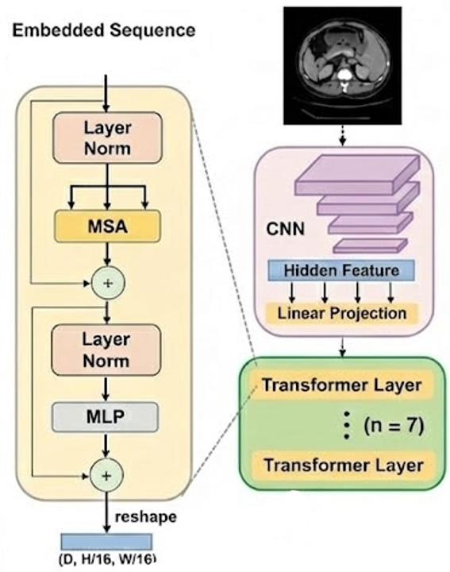
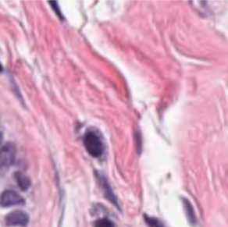
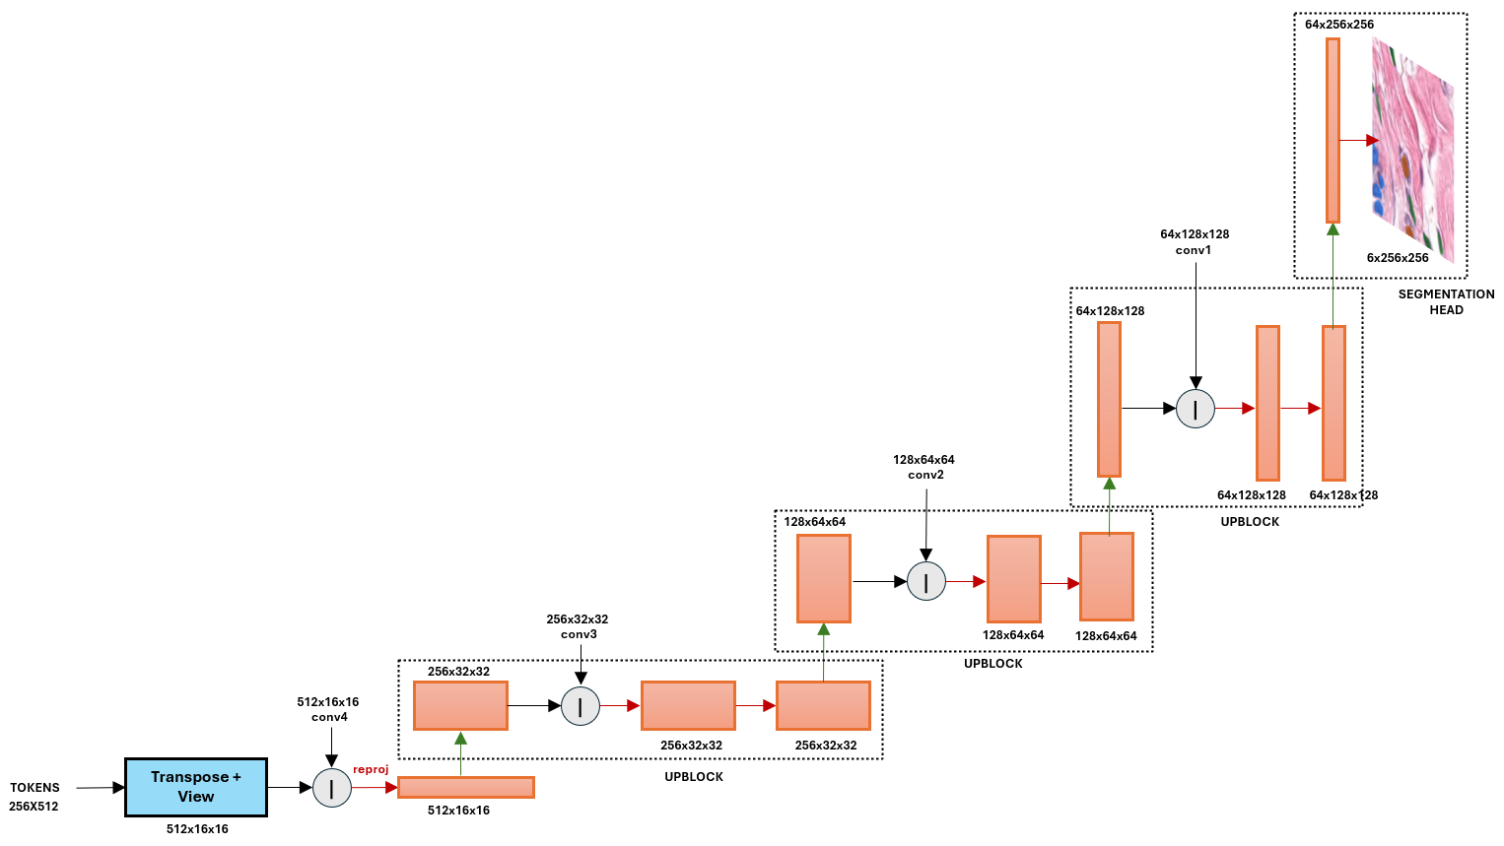

Slide 6
